Slide 1
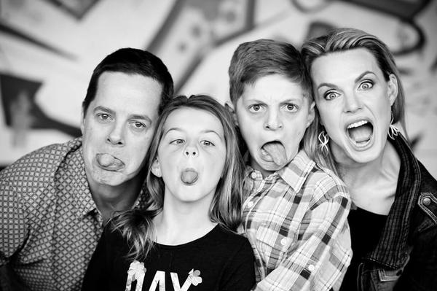
Friends don’t let friends...
…stay unreconciled
Be God’s agent for peacemaking!
Check out a free self study course at www.aorhope.org/aor-gift
Pay it forward. Donate just $5 for someone else.
Refer your friends.

